Slide 1
An Advanced Introduction to PowerShell for SharePoint
Developers and Administrators
Michael Blumenthal & Jack Fruh

Slide 2

Who is Michael Blumenthal?
Sr. Solution Architect
at PSC Group
CSPUG Co-Leader
19 years in IT Consulting
11 years working with
SharePoint
7 years with PowerShell
Notes:
PSC is a title sponsor

Slide 3


Who is Jack Fruh?
SharePoint Administrator
  Fortune 500 Company
Big on community
  SPS Chicago Suburbs Co-Leader
  SharePointJack.com
  SPYam
  SharePoint-Community.org
  CloudSaturday.com

Slide 4
This is about you
Version of SharePoint?
Admin, Developer, Both, Other?
PowerShell experience?
SharePoint experience?
Notes:
Anyone here not done SharePoint development?
What kind of development have you done?
Who has worked with PowerShell already? Used for what? Your name?
Who has worked with other scripting languages?

Slide 5
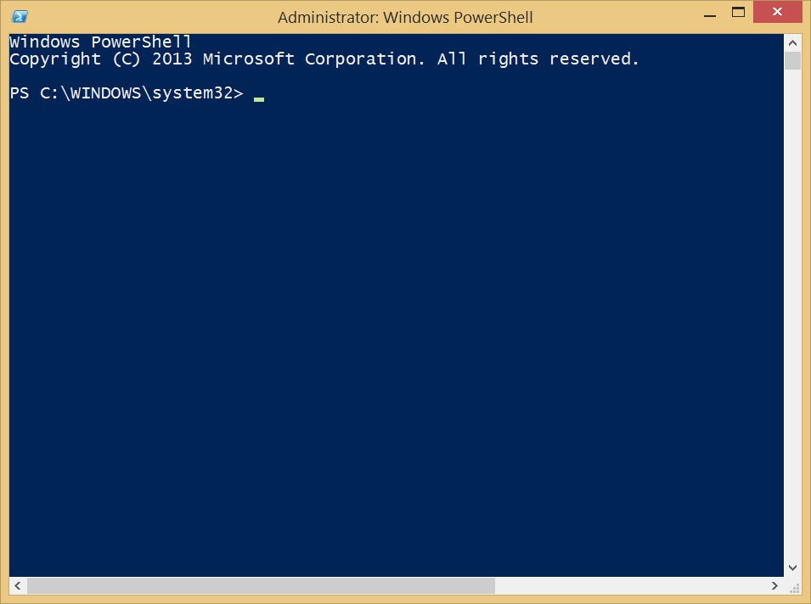
Why?
Notes:
Command line control of SharePoint at your fingertips?
Every SharePoint Developer & admin needs this!
Fast and Flexible
Great for LastMile Problems. New MSFT std for command line & remote admin.
No Visual Studio.

Slide 6
PowerShell puts the SharePoint Engine at your fingertips!
1
4
Practical Uses
2
3
It’s Easy to Get Started!
Learn the PowerShell Syntax
Best Practices
5
Scripting Q&A, Raffle
Notes:
Who would like another tool in their toolbox, one that will help them with SharePoint, but also with many other things? How about the swiss army knife of tools?
It will make you a better developer!

Slide 7
Chapter 1
It’s Easy to get Started!

Slide 8
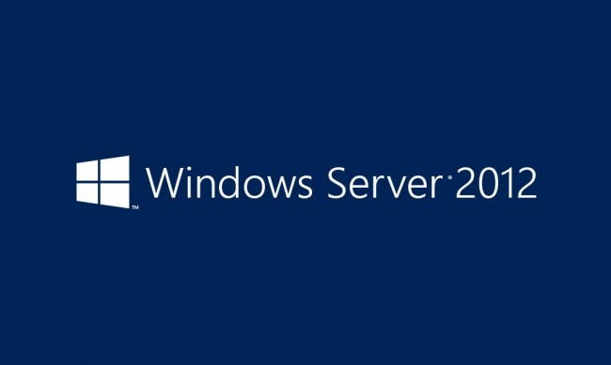
Getting Started with PowerShell
2003
2008, R2,
2012, R2
7, 8, 8.1, 10…
Notes:
Who here already has installed and PowerShell?
Win 2003: http://www.microsoft.com/windowsserver2003/technologies/management/powershell/download.mspx
Win 2008 – It’s an OS Feature – “servermanagercmd –install PowerShell”
Win2008R2 – it’s already installed

Slide 9
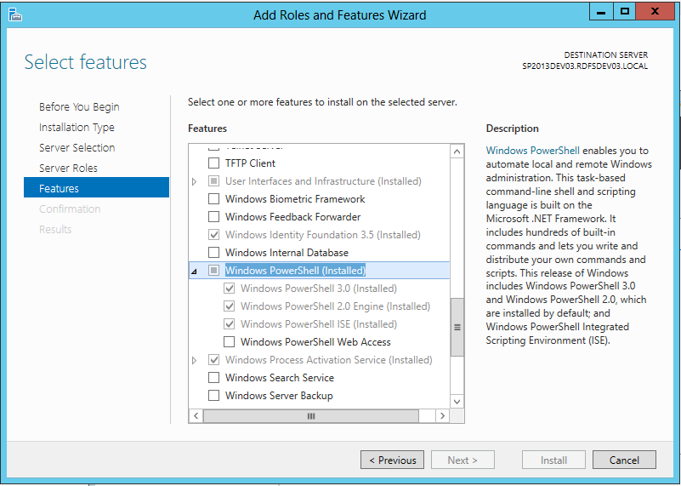

Slide 10
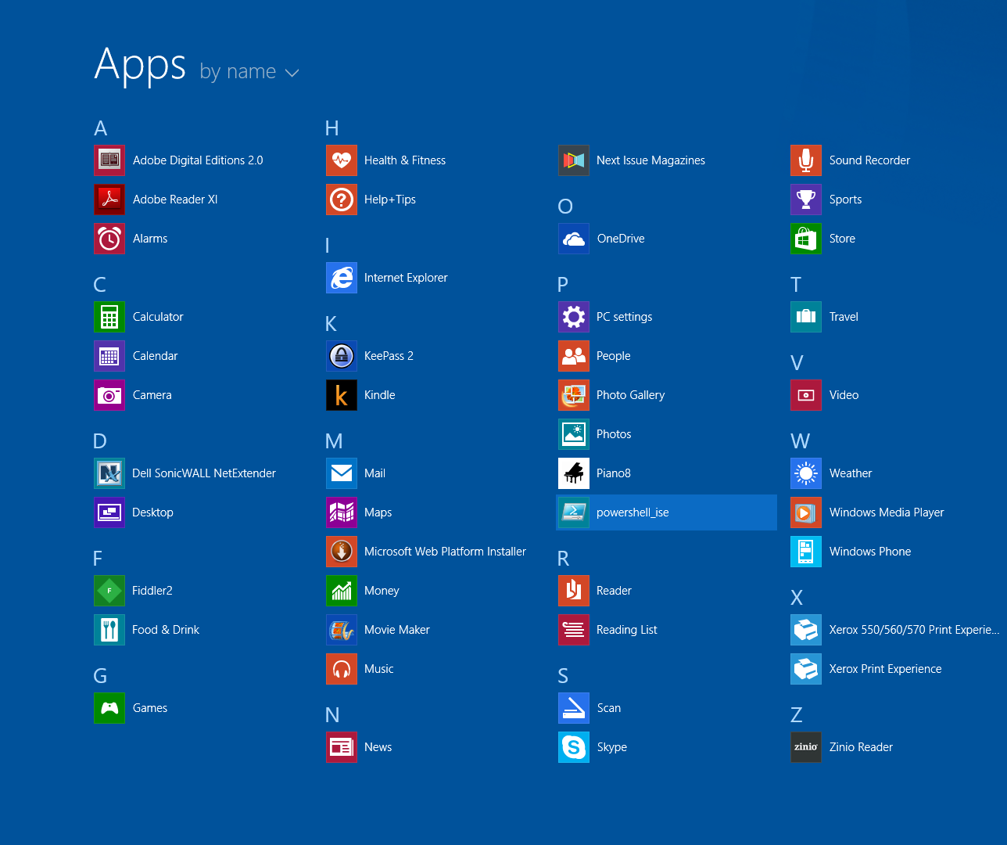
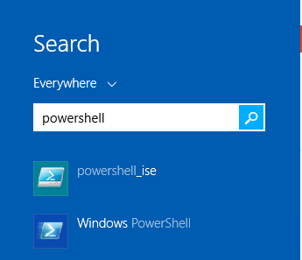

Slide 11
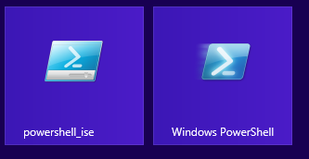

Slide 12
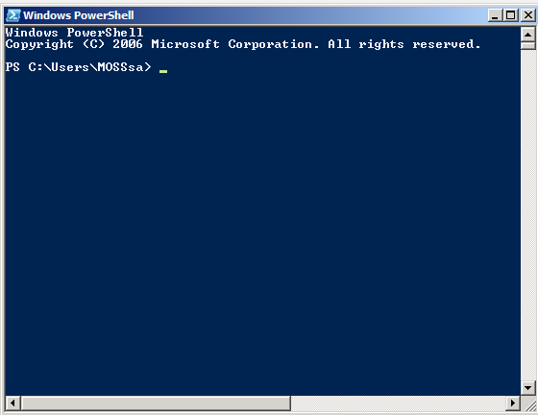
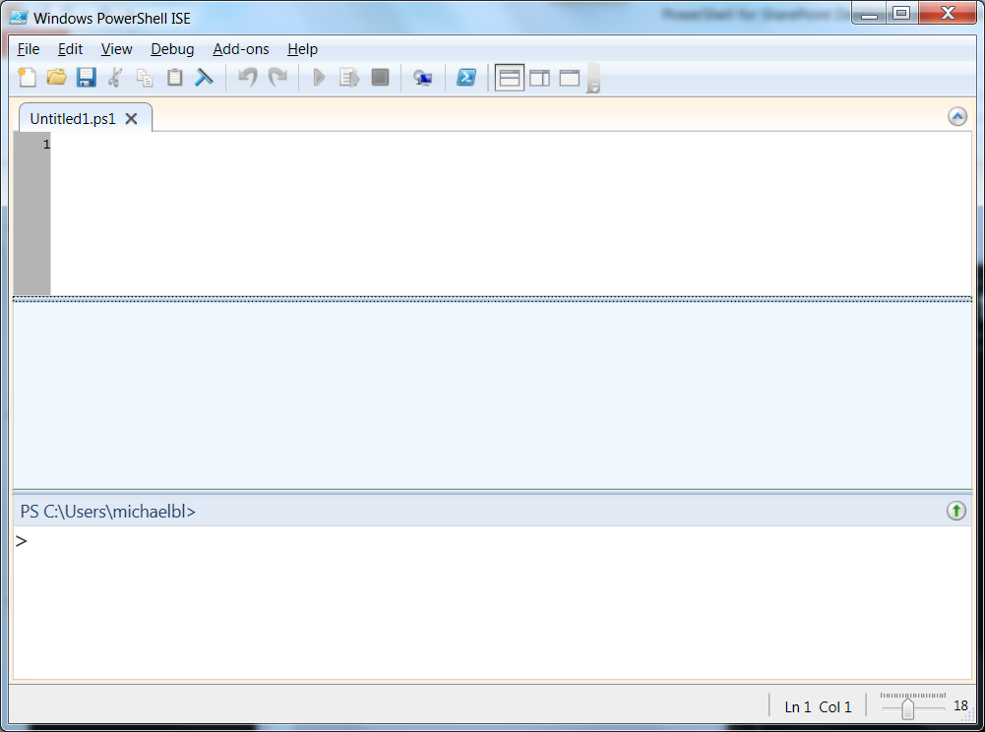
V2
Use With SP2010

Slide 13
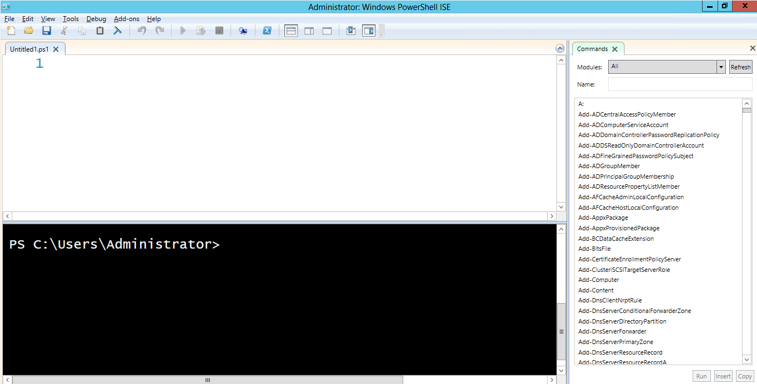
PowerShell v3 & v4 ISE
V3
Use With SP2013

Slide 14
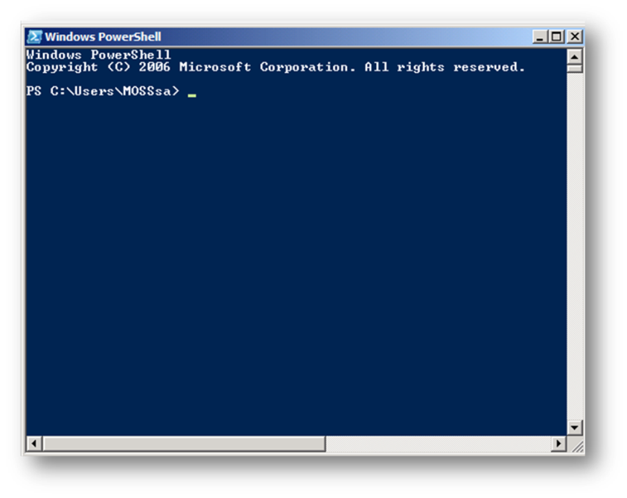
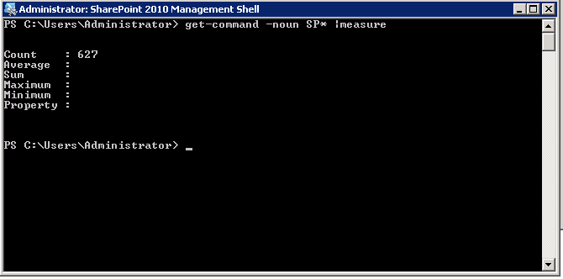
POSH vs the SharePoint Mgmt Shell
Notes:
One is SharePoint aware, the other isn’t!

Slide 15
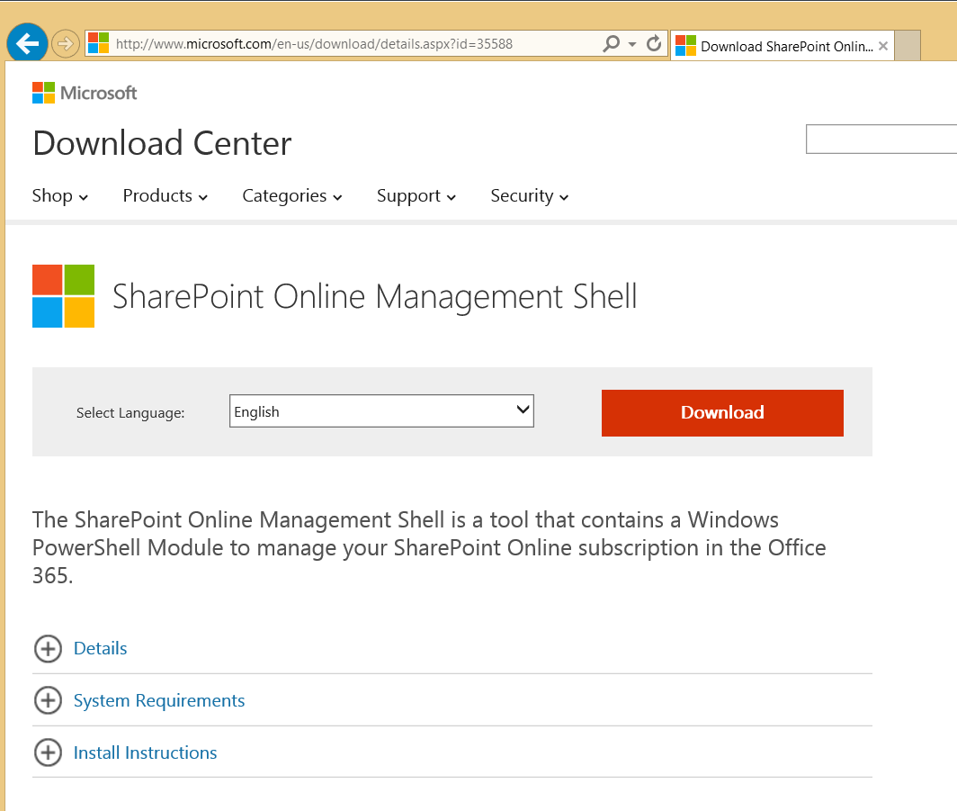
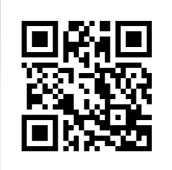
Managing On Prem vs Online
http://bit.ly/POSH4SPO
Notes:
Download SPO Cmdlets here: http://www.microsoft.com/en-us/download/details.aspx?id=35588

Slide 16
Chapter 2
Learn the PowerShell Syntax!

Slide 17
Learn to use PowerShell with SharePoint!
Fundamentals
Using the SharePoint API

Slide 18

Symbols, Keywords, and Syntax! Oh My!
Variables
Comparisons
Flow Control
Commands
Piping
1
2
3
4
5
6
Filtering
7
Scripts
8
Debugging

Slide 19
Reading Symbols in Code
(tal Guidance
Moe, Larry, and }
The universe started with the Big !
!Important
A # of Bacon and # Browns

Slide 20
Variables begin with a $
1
$something
$true, $false, $profile, $null
$MyMessage = “Hello, World”
Case Insensitive, Dynamic typing
Notes:
Name that Language…
Similar to @variables in SQL, apparently also Ruby, PHP.
Arrays start at 0

Slide 21
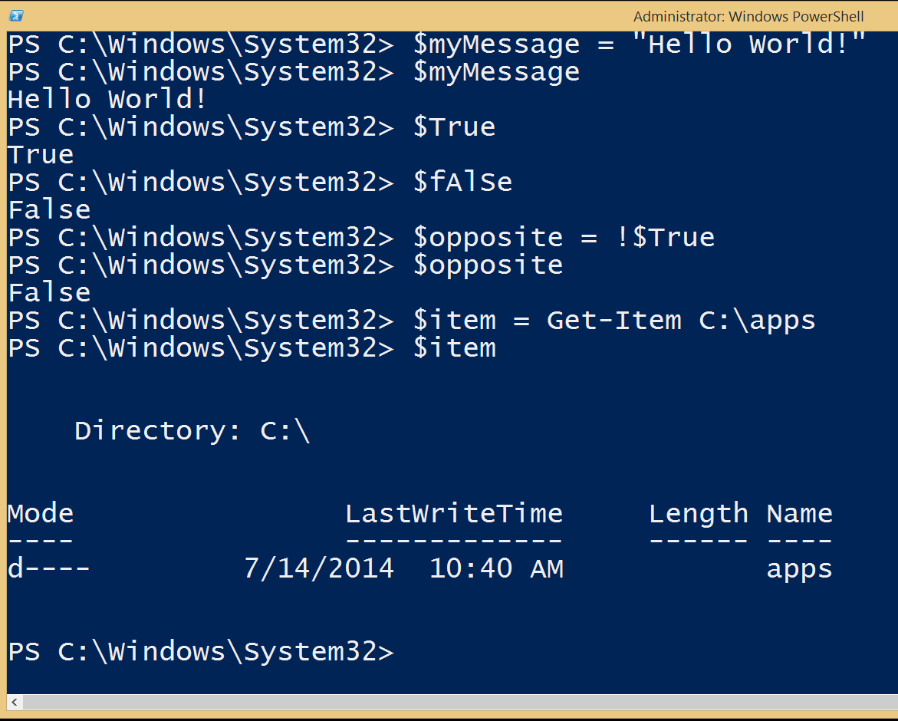

Slide 22
Commands are called cmdlets.
2
Verb-Noun
Get-Help & Help
Built-in, Extensible
Get-Member
Get-Command
Notes:
Mention Aliases

Slide 23
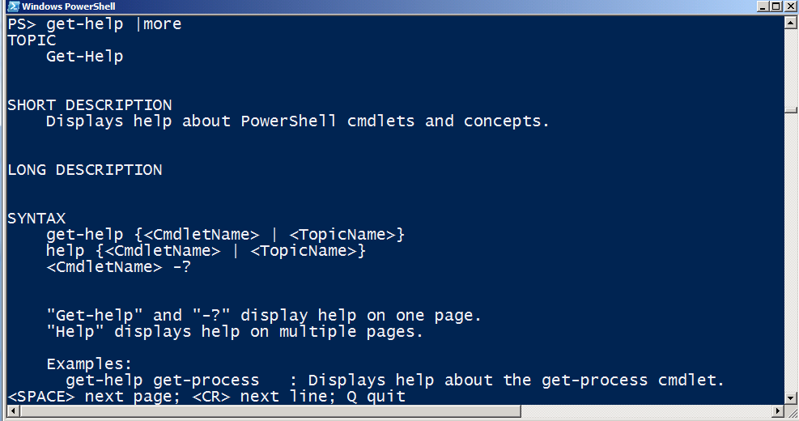
Get-Help
Notes:
Like a UNIX Manpage!

Slide 24
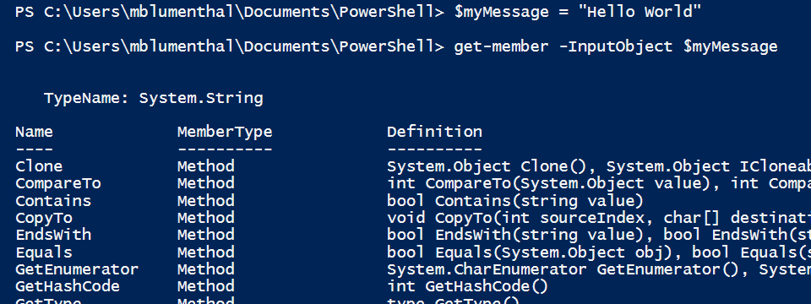
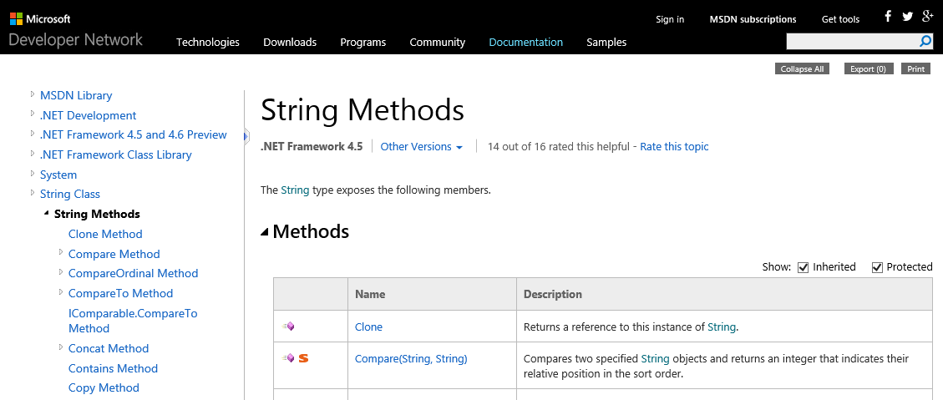
Discoverability
Notes:
Get-Member examples

Slide 25
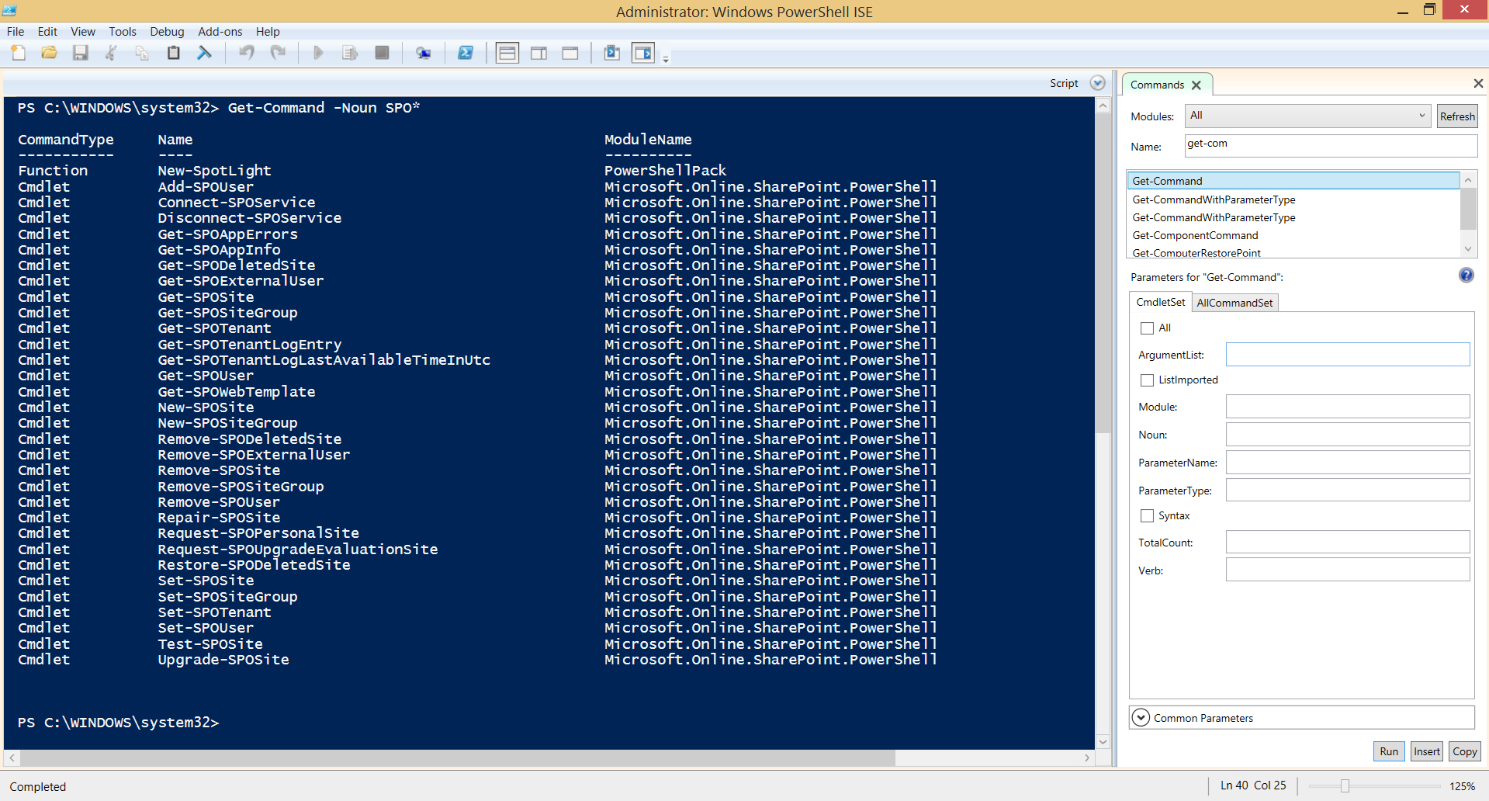
Discover Commands: Get-Command
Notes:
Get Command Examples

Slide 26
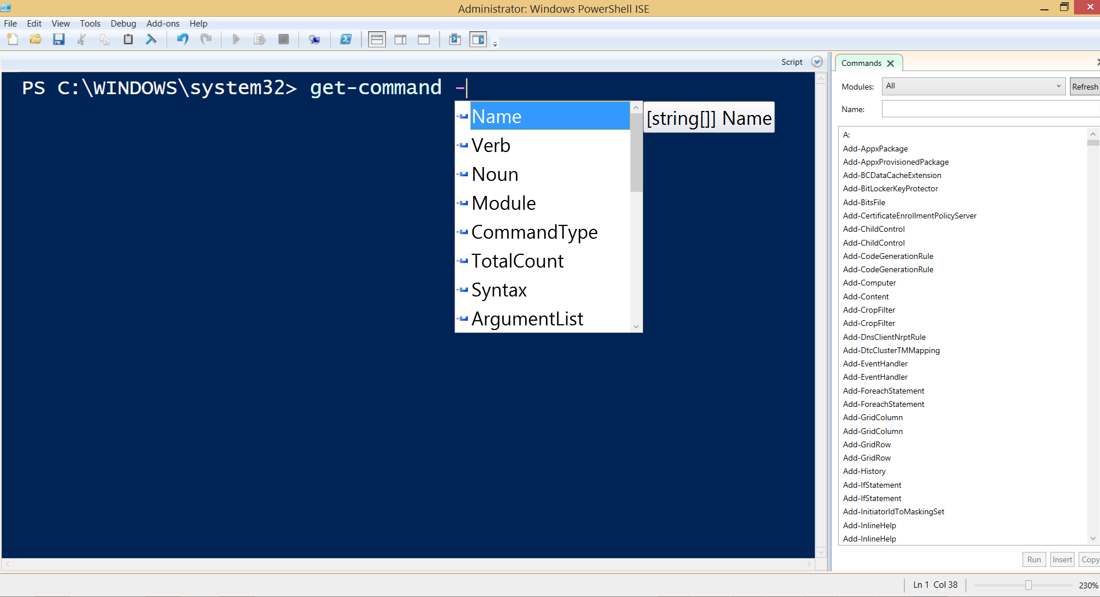
Intellisense!
Notes:
Intellisense!

Slide 27
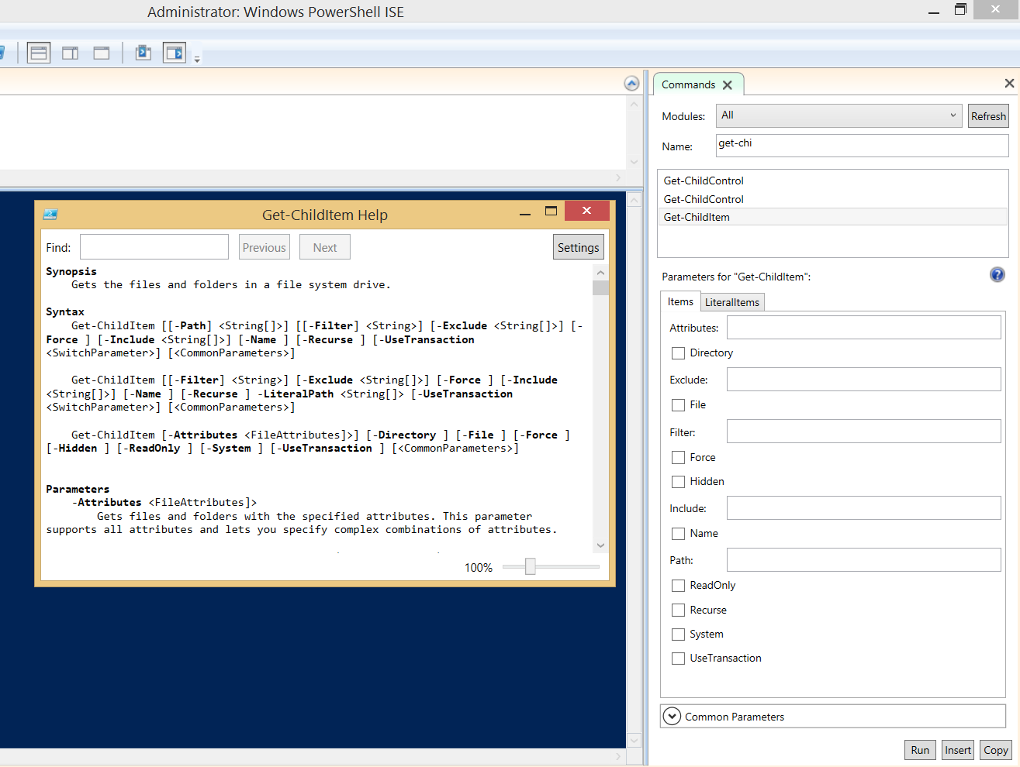
Refresh the command list
Find custom commands this way
Actions you can take once
you fill in parameters

Slide 28
The Power of Piping!
3
Output Of Command 1
Input of Command 2
|

Slide 29
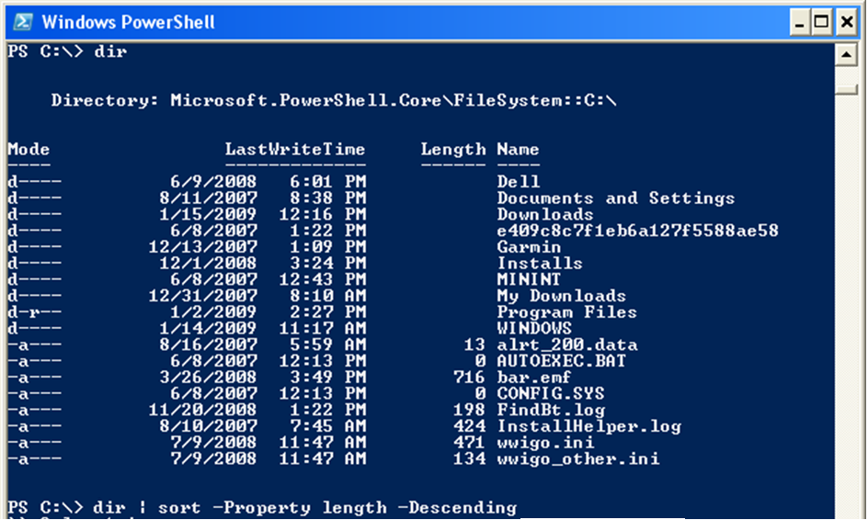
Example
Notes:
Ask if anyone has unix scripting experience, and what they think of this.
Can you imagine trying to do this in unix or vbscript?

Slide 30
Making Comparisons
4
Operator | Meaning |  | Operator | Meaning
-eq | Equals |  | -le | Less Than or Equal To
-ne | Not Equals |  | -like | Wildcard Match
-gt | Greater Than |  | -notlike | Not (Wildcard Match)
-ge | Greater Than or Equal To |  | -match | Reg. Exp. Match
-lt | Less Than |  | -notmatch | Not (Reg. Exp. Match)

Slide 31
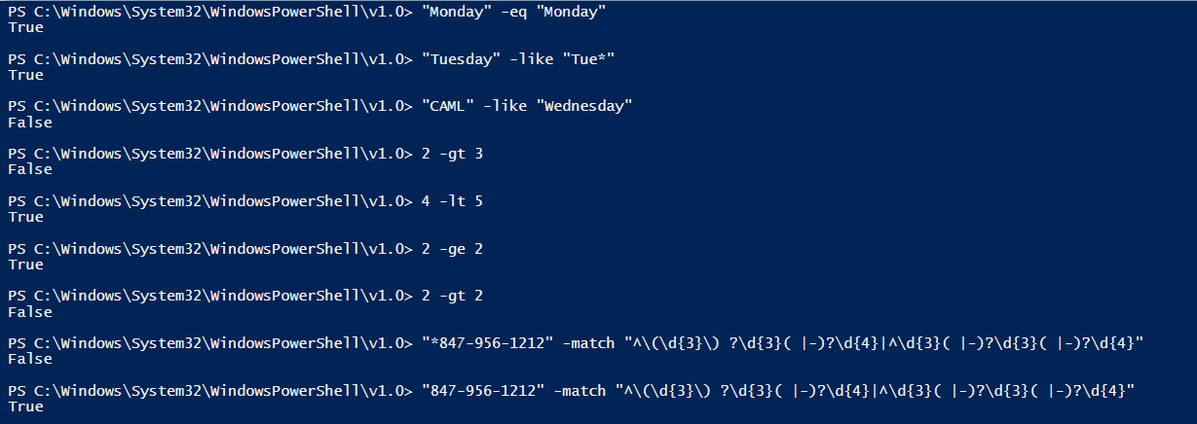
Example

Slide 32
Taking Control of the Flow
5
For
ForEach
If
While
For (Init;Test;Repeat) {Commands}
for($i=1; $i -le 10; $i++) {Write-Host $i}
Foreach (Item in Collection) {Commands}
Foreach ($web in $site.AllWebs) {$web.Title}
If (Test) {Commands}
if ($web.Title –ne “”) {Write-Host $web.Title}
While (Condition){Commands}
while($val -ne 3){$val++; Write-Host $val}
Notes:
Get-Help about_flow_control
Mention that collections start at 0

Slide 33
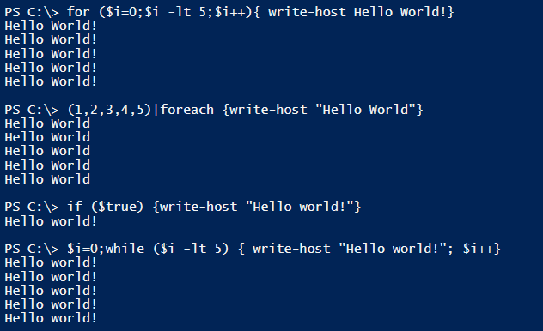
Example
Notes:
Ask if anyone has unix scripting experience, and what they think of this.
Can you imagine trying to do this in unix or vbscript?

Slide 34
Where-Object
6
Syntax
Example
Where {<Test>}
V1&2:Dir | Where {$_.Name –like
“B*”}
V3:Dir | where Name –like B*

Slide 35
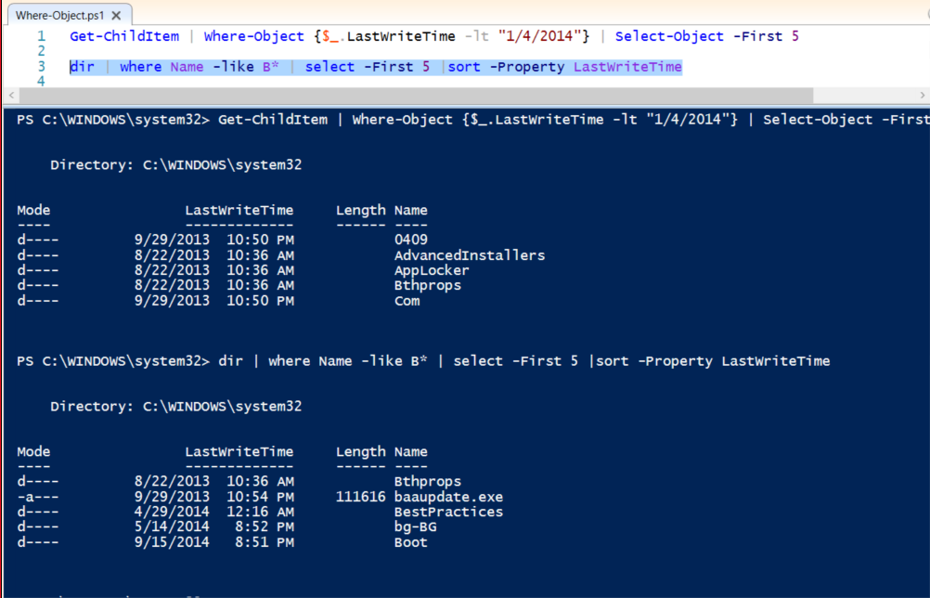

Slide 36
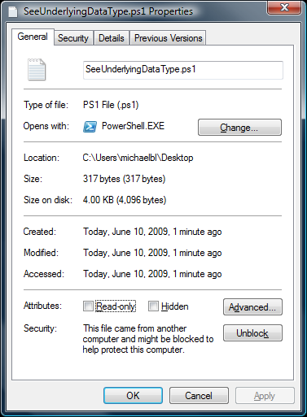
Executing Scripts
7
.\filename.ps1
Set-ExecutionPolicy Unrestricted

Slide 37
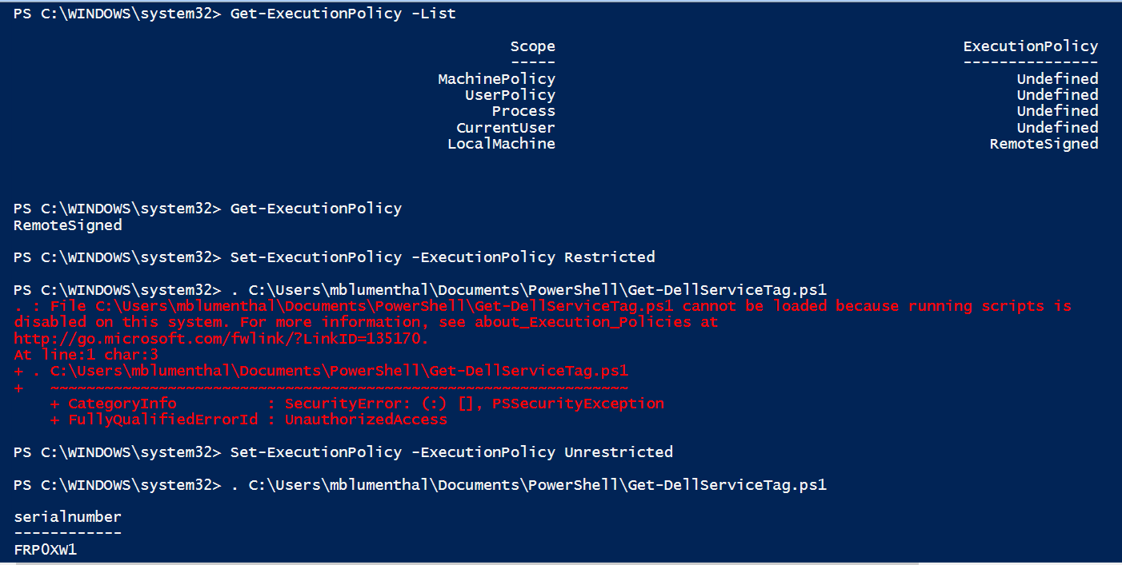
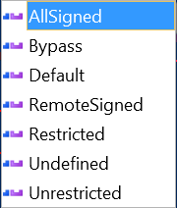
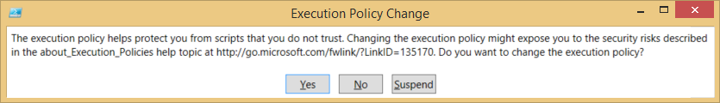

Slide 38
Creating a function
Function global:Do-Something ($param, …){
# put cmdlets here…
}

Slide 39
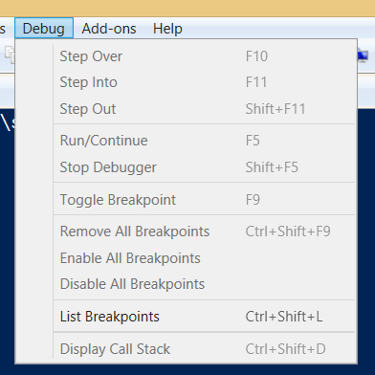
ISE Debugging
8

Slide 40
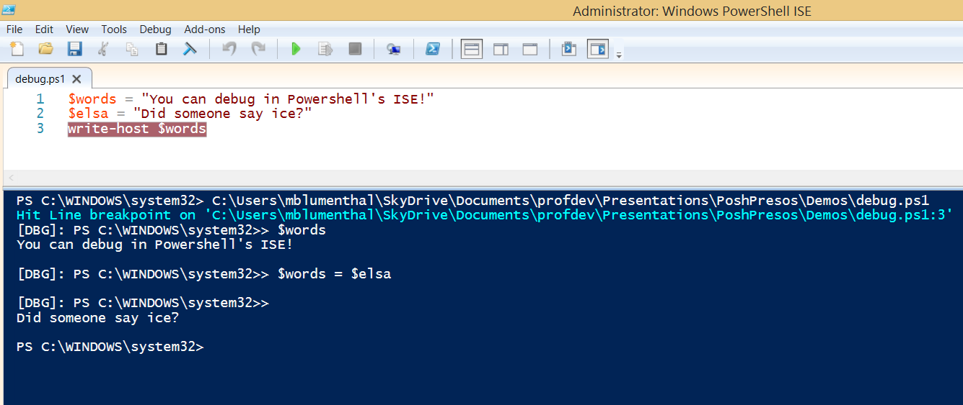
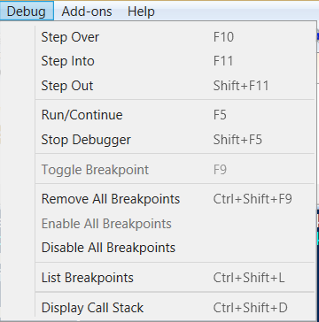
Screenshot
ISE Debugging

Slide 41
In Review
Variables
Comparisons
Flow Control
Commands
Piping
1
2
3
4
5
6
Filtering
7
Scripts
8
Debugging

Slide 42

Using the SharePoint API
Understand the OM
2
3
1
Load Cmdlets
Use ’em!

Slide 43
Highlights from the SharePoint Object Model
SPWebApplication
SPWeb
SPList
SPListItem
SPField
SPFarm
SPSite
School
Classroom
Book
Page
Word
District
Department
Notes:
If you are familiar with these objects, raise your hand.

Slide 44

Loading SharePoint Cmdlets
C:\...\14 or 15\CONFIG\POWERSHELL\
Registration\SharePoint.ps1:
Add-PsSnapin Microsoft.SharePoint.PowerShell

Slide 45
Loading SharePoint DLLs
Works in MOSS 2007 too!
[void][System.Reflection.Assembly]::
LoadWithPartialName("Microsoft.SharePoint")

Slide 46
Get a Site and Explore it!
$site = get-spsite http://server/path
THEN
$site

Slide 47
Demo
Notes:
Now that you know all the fundamentals, Jack will show you how to apply them

Slide 48
Break

Slide 49
Chapter 3
Best Practices

Slide 50
Best Practices
1
2
3
Make accidentals runs harmless
Follow the Verb-Noun pattern
Comment Your Functions
Write your scripts as functions that announce themselves
4
Use Source Control
Notes:
http://technet.microsoft.com/en-us/magazine/ff458353.aspx

Slide 51
Verb-Noun = Action-Thing
42 verbs combined with 347 nouns to give us 799 cmdlets
Add
Backup
Clear
Connect
Convert
Copy
Disable
Disconnect
Dismount
Enable
Etc…
SPAppDeniedEndpoint
SPClaimTypeMapping
SPDiagnosticsPerformanceCounter
SPDistributedCacheServiceInstance
SPEduClassMember
SPEduUser
SPInfoPathUserAgent
SPPluggableSecurityTrimmer
SPProfileLeader
SPProfileSyncConnection
Etc…
Notes:
Try to use an existing verb. You can make your own Noun Prefix if you want.

Slide 52
Comment your functions
<#
.SYNOPSIS –a brief explanation of what the script or function does.
.DESCRIPTION – a more detailed explanation of what the script or function does.
.PARAMETER name – an explanation of a specific parameter. Replace name with the parameter name. You can have one of these sections for each parameter the script or function uses.
.EXAMPLE – an example of how to use the script or function. You can have multiple .EXAMPLE sections if you want to provide more than one example.
.NOTES – any miscellaneous notes on using the script or function.
.LINK – a cross-reference to another help topic; you can have more than one of these. If you include a URL beginning with http:// or https://, the shell will open that URL when the Help command’s –online parameter is used.
#>

Slide 53
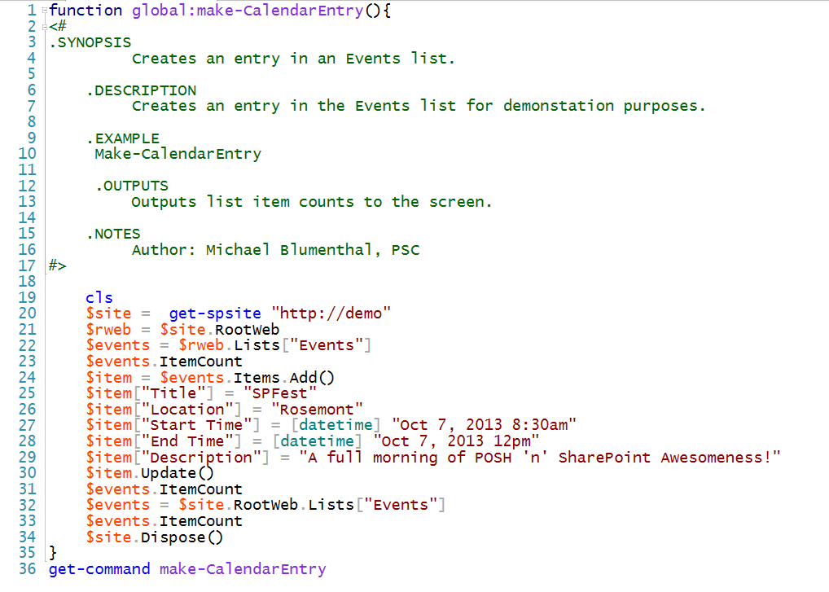
Notes:
about_comment_based_help

Slide 54
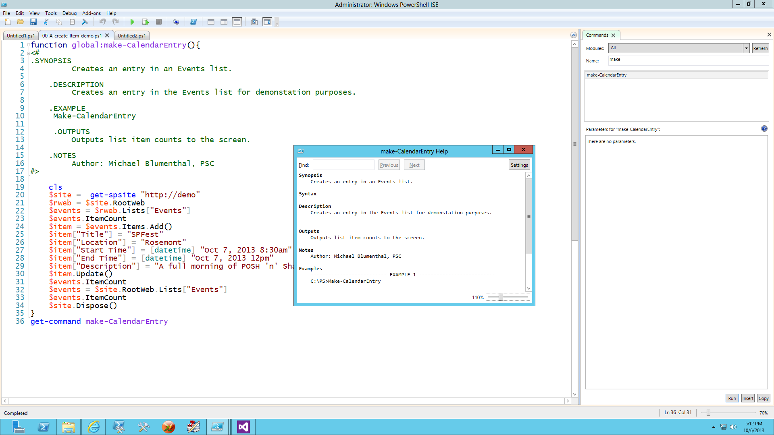
Find custom commands this way
Refresh the command list

Slide 55
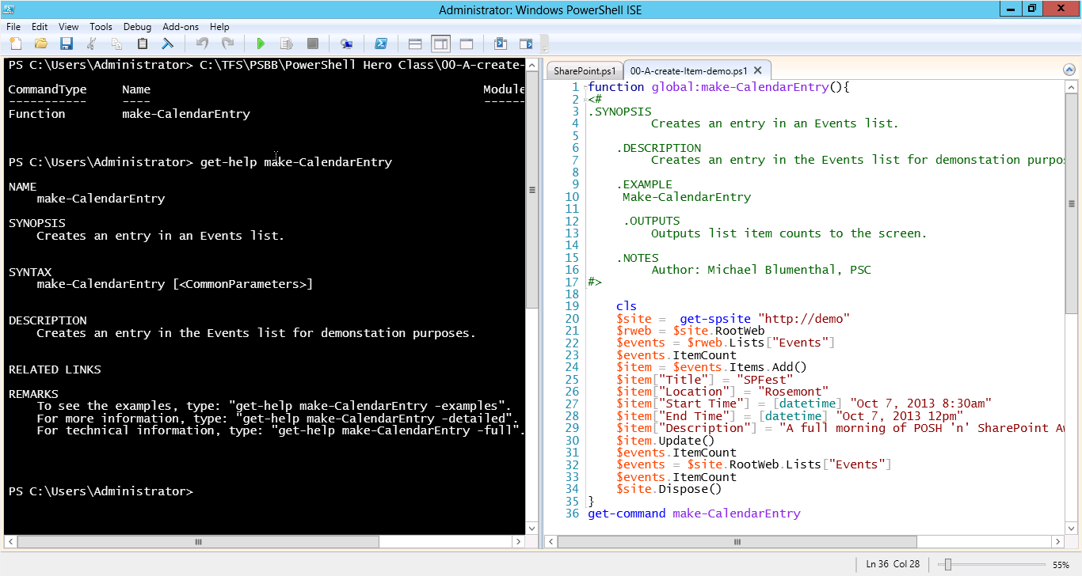

Slide 56
More Good Ideas
Always read scripts before running them
Make it safe for others to not read them first
Write scripts as functions most of the time
Check for valid parameter values
Do error handling

Slide 57
A Word About Memory Management
SPWeb
SPSite
Inline
In Script
Dispose
Notes:
Your mother doesn’t work here! You must clean up after yourself.

Slide 58
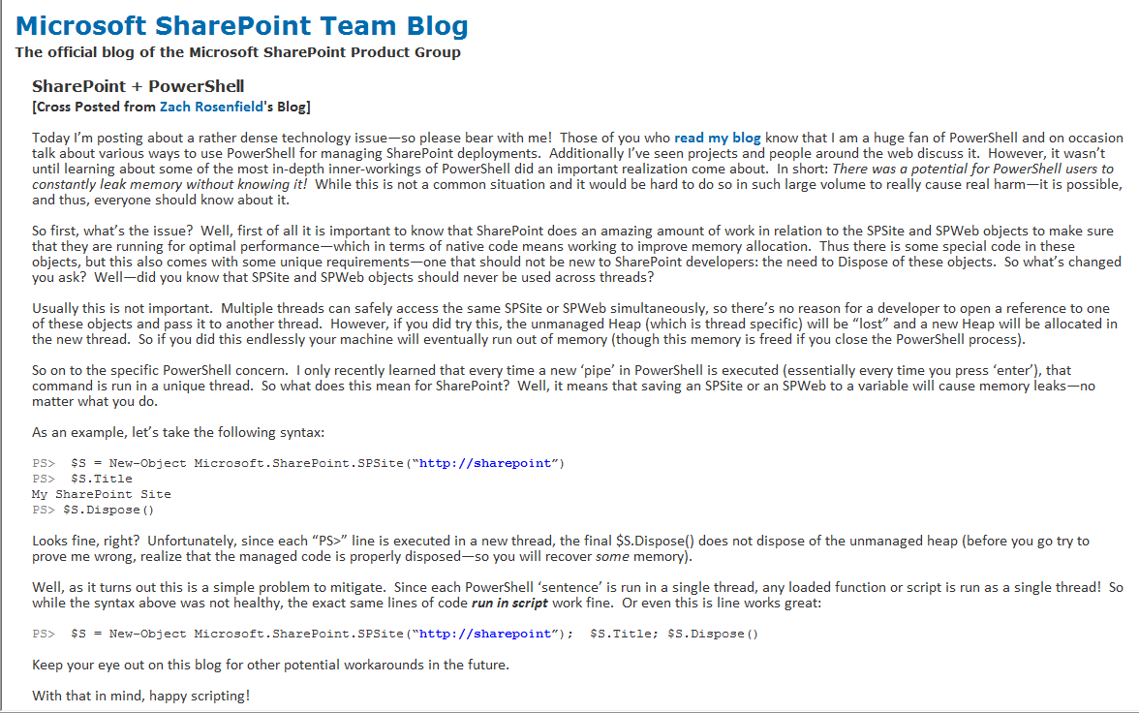
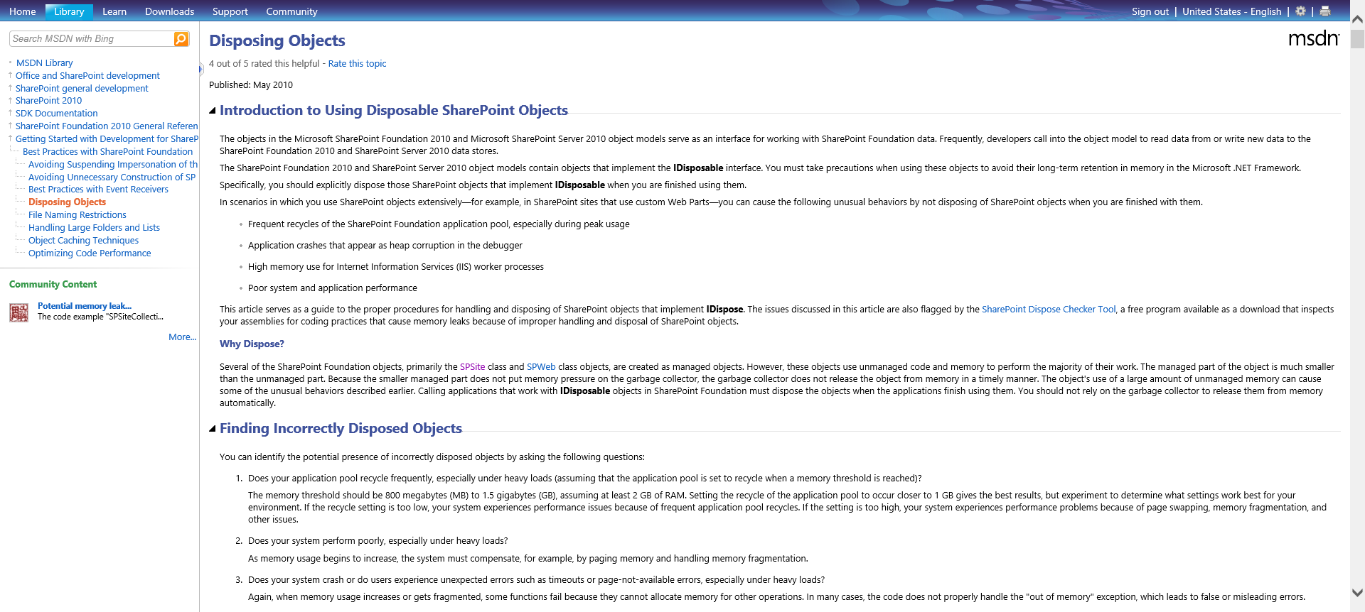
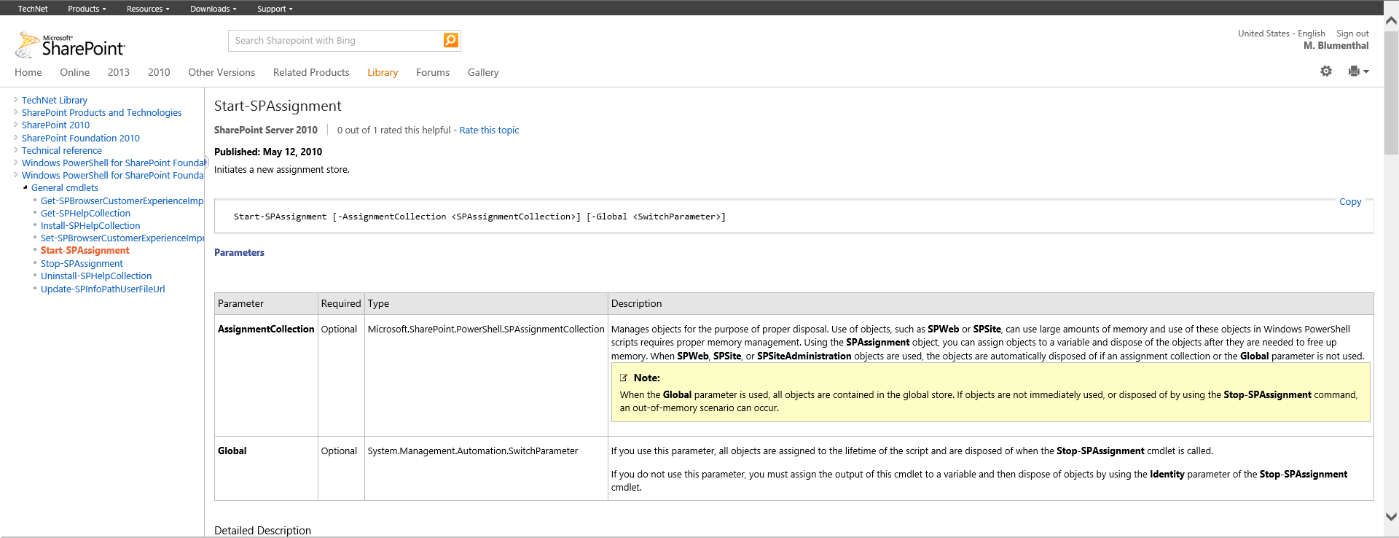
Notes:
http://sharepoint.microsoft.com/blog/Pages/BlogPost.aspx?PageType=4&ListId={72C1C85B-1D2D-4A4A-90DE-CA74A7808184}&pID=524
http://msdn.microsoft.com/en-us/library/ee557362.aspx
See Assignment collections - http://technet.microsoft.com/en-us/library/ff607664.aspx

Slide 59
Chapter 4
Practical
Uses

Slide 60
Practical Uses
Bulk Create Sites
List Item CRUD
3
4
1
2
Create data for test cases
Associate Workflows with a List

Slide 61
More Practical Uses
Sync Wep App Properties
5
Work across site collections
6
Deployment Scripting
7
Identify files that won’t upload
8

Slide 62
More Practical Uses
9
Check the Farm Version
Install SharePoint
10
Repeatably Manage Content
11
Update Field Definitions
12

Slide 63
More Practical Uses
13
Managing Azure and SPO
15
Document Versioning Settings
14
Custom Reports on Permissions
16
SSL Cert Expiry Alerts

Slide 64
What’s your SharePoint Version?
PS C:\Users\Administrator> $(get-SPFarm).BuildVersion
Major Minor Build Revision
----- ----- ----- --------
14 0 6109 5002

Slide 65
Audio Alerts
Stick this at the end of your long running script:
$Voice = new-object -com SAPI.SpVoice
$Voice.Speak(“Deployment is done!")

Slide 66
Email Alerts
Send-MailMessage [-To] <string[]> [-Subject] <string> [[-Body] <string>] [[-SmtpServer] <string>] -From <string> [-Attachments <string[]>] [-Bcc <string[]>] [-BodyAsHtml] [-Encoding <Encoding>] [-Cc <string[]>] [-DeliveryNotificationOption <DeliveryNotificationOptions>] [-Priority <MailPriority>] [-Credential <pscredential>] [-UseSsl] [-Port <int>] [<CommonParameters>]

Slide 67
Review
1
4
Practical Uses
2
3
It’s on your machine!
Know the PowerShell Syntax
Use Best Practices
5
Do it now!
Notes:
Who would like another tool in their toolbox, one that will help them with SharePoint, but also with many other things? How about the swiss army knife of tools?
It will make you a better developer!

Slide 68
Chapter 5
Scripting Q&A

Slide 69
Bulk Site Creation
PowerShell & Excel & UI
Site Definitions in V. Studio
Not an answer by themselves
Define site content
Intended for reuse
  Mismatch to one time need
CAML and PITA
Harder: Making it data driven
Change Site Def -> Recreate Site
Well suited for one time “blow in’s”
Define the site template in the UI or use standard
Save as a template
  Even pub sites - sometimes
PowerShell has easy loops
Data driven from a CSV
Changes -> Mod Scripts
Notes:
Michael

Slide 70
The PowerShell Solution
Read the list of sites from CSV
Loop:
  Create Site
  Configure Site
    Turn on Features
    Set Master Pages, Welcome Page
    Hide Libraries, set versioning
    Adjust Navigation
  Add Lists, Libraries, Pages, Web parts, etc
Loop again & again if needed – iterative!
Notes:
Once used a choice column’s values instead of a CSV

Slide 71
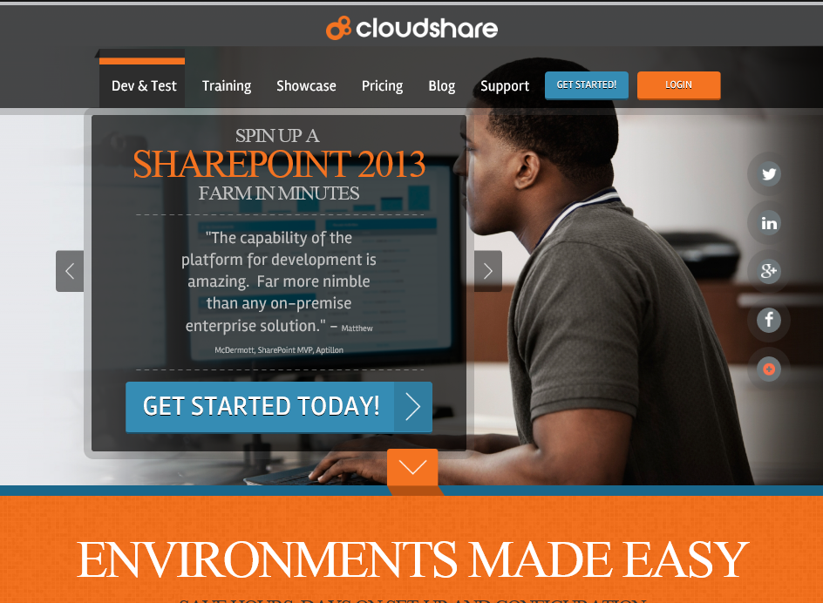
Notes:
Thanks for the VM, Cloudshare!

Slide 72
Book Raffle
Put your card in the box

Slide 73
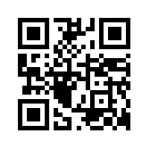
Tonight only!
CSPUG’s SPFest Speaker Panel Discussion
6-7:30pm
http://bit.ly/201412CSPUGReg

Slide 74
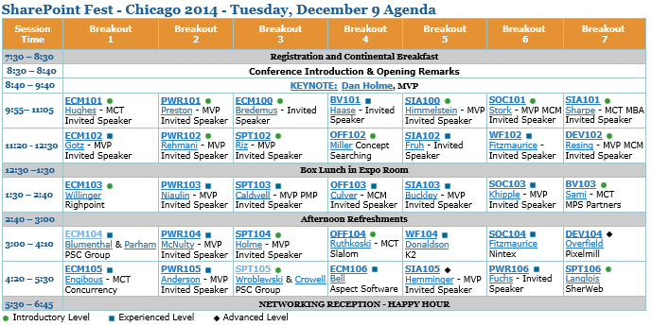
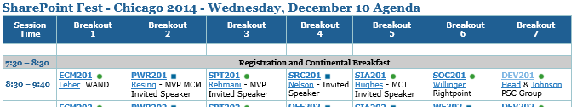
Our Other Sessions

Slide 75
Questions & Thank You
Thank you for your time today.
Michael Blumenthal
SharePoint Architect
PSC Group, LLC
MBlumenthal@psclistens.com
www.psclistens.com
MichaelBlumenthal.me
@MichaelBL
LinkedIn
SPYam
Jack Fruh
SharePoint Admin
Jack@SharepointJack.com
SPSChicagoSuburbs.com
SharePointJack.com
@SharePointJack
LinkedIn
SPYam

