Slide 1


SharePoint PowerShell
Time Machine
Presented by Jack Fruh
@SharePointJack #SPFestChi jack@SharePointJack.com

Slide 2
Course Description
SharePoint PowerShell Time Machine
Have you ever wished you had more hours in the day?
We might have the next best thing!
Find out how you can go back in time using PowerShell with SharePoint!
In this class you'll learn the basics of PowerShell with SharePoint, and you'll see a few scripts that can help you go back in time by enabling versioning, recording Site Groups and Users and more. Between our "time travel" scripts, and scripts that just save time, this is one session that pays for itself. This material is all usable on "Day 1" when you return to the office!
@SharePointJack #SPFestChi jack@SharePointJack.com

Slide 3
Introductions - Me
@SharePointJack #SPFestChi jack@SharePointJack.com
Jack Fruh
http://sharepointjack.com
@sharepointjack on twitter
SP admin at a fortune 500 with 45k employees.
Email: jack@sharepointjack.com

Slide 4
Introductions - You
What do you hope to get from this?
Who is new to PowerShell?
Who is new to SharePoint?
Does everyone know the object model?
@SharePointJack #SPFestChi jack@SharePointJack.com

Slide 5
SharePoint Object Model
Farm
Web Application
Site Collection
Web (& subwebs)
Lists, users
@SharePointJack #SPFestChi jack@SharePointJack.com

Slide 6
Back In Time Scripts
Enable Versions Everywhere
Record SharePoint Permissions
Record Size of Content DB and Site collections
@SharePointJack #SPFestChi jack@SharePointJack.com

Slide 7
Demo Time
@SharePointJack #SPFestChi jack@SharePointJack.com

Slide 8
Time Saving Scripts
Simple WSP Deployment Script
Add an admin to every site collection
Map all your network drives at once
SP WarmUp Script
@SharePointJack #SPFestChi jack@SharePointJack.com

Slide 9
Demo Time
@SharePointJack #SPFestChi jack@SharePointJack.com

Slide 10
Script Foundations
Download and Print SharePoint PowerShell Cheat Sheet
Simple Script Logging
Send Email from your scripts
Use $false not false
Don’t use quickedit mode in Production
Oddbal errors? Check file format (UTF-8)
@SharePointJack #SPFestChi jack@SharePointJack.com

Slide 11
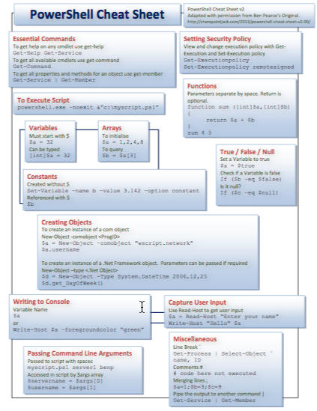
PowerShell CheatSheet

Slide 12
Demo Time
@SharePointJack #SPFestChi jack@SharePointJack.com

Slide 13
Q&A
@SharePointJack #SPFestChi jack@SharePointJack.com

Slide 14
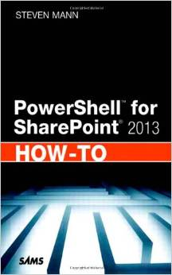
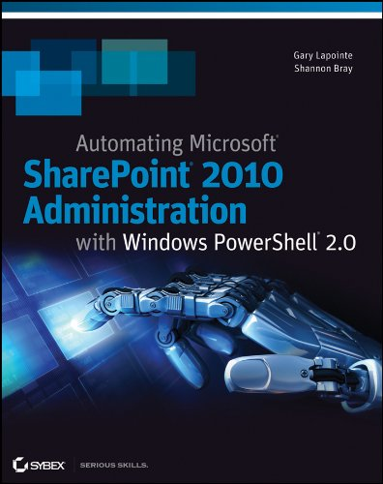
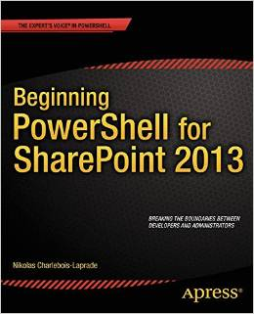
Resources
@SharePointJack #SPFestChi jack@SharePointJack.com
Great Resources:
PowerShell cheat sheet:
http://sharepointjack.com/2013/powershell-cheat-sheet-v2-00/
Pluralsight course on PowerShell with SP by Gary LaPointe
SPYAM group on Yammer
SharePoint-Community.net
Books:

Slide 15
My info
Jack Fruh
Blog: SharePointJack.com
Email: jack@sharepointjack.com
Twitter: @SharePointJack
Linkedin: http://www.linkedin.com/in/jackfruh
Skype: jack.fruh
(If you want to connect on Linked in or Skype, tell me who you are so I know we’ve met.)
@SharePointJack #SPFestChi jack@SharePointJack.com

